Slide 1

AI-Powered Rate Confirmation Processing Automation
UiPath • Document Understanding • AI Workflow Automation
Maryna Khlynina

Slide 2


Business Context
z
In carrier operations, rate confirmations are received daily from brokers in varying formats and must be processed quickly to support reporting, profitability analysis, and operational decision-making.
Operational Challenges
High daily volume of rate confirmations
Manual shipment data extraction
Separate mileage lookup process
Repetitive spreadsheet entry
Inconsistent broker document formats
Difficult to scale reporting workflows
Business Impact
~5 hours/week spent on repetitive processing
Increased risk of manual data errors
Delayed RPM and profitability reporting
Reduced operational visibility and scalability

Slide 3
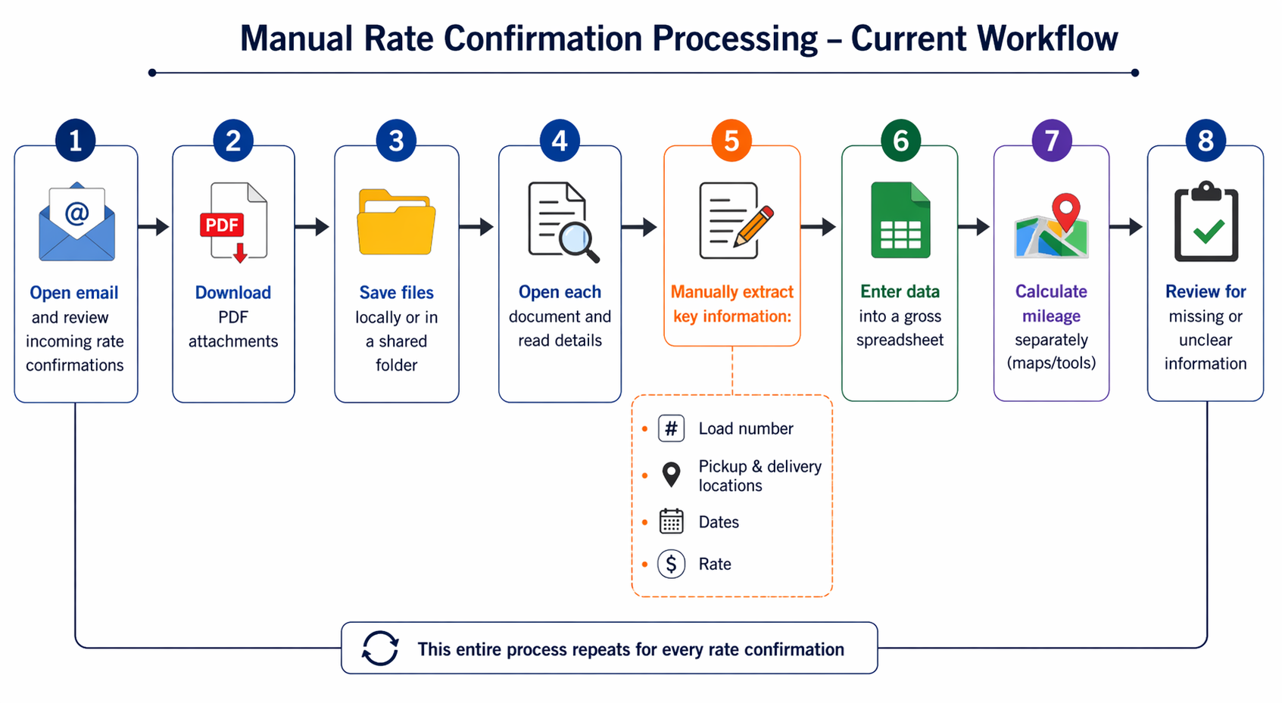
Manual Rate Confirmation Processing
The current manual workflow for processing rate confirmations involves repetitive tasks such as document handling, manual data extraction, and separate mileage calculation using external tools like Google Maps, where each location must be entered manually.
z

Slide 4
Automation Solution
An end-to-end UiPath automation was developed to streamline rate confirmation processing by combining AI-powered document extraction, mileage enrichment, validation logic, and structured spreadsheet reporting into a single scalable workflow.
The solution reduces repetitive manual processing while improving operational visibility, reporting efficiency, and data consistency.
Core Capabilities:
Automatically retrieves rate confirmations from email
Stores and organizes documents in Google Drive
Extracts shipment data using Document Understanding
Calculates mileage using AI-based enrichment
Writes structured output directly into reporting spreadsheets
Flags incomplete or low-confidence data for manual review
Sends automated validation alerts when issues are detected
z

Slide 5
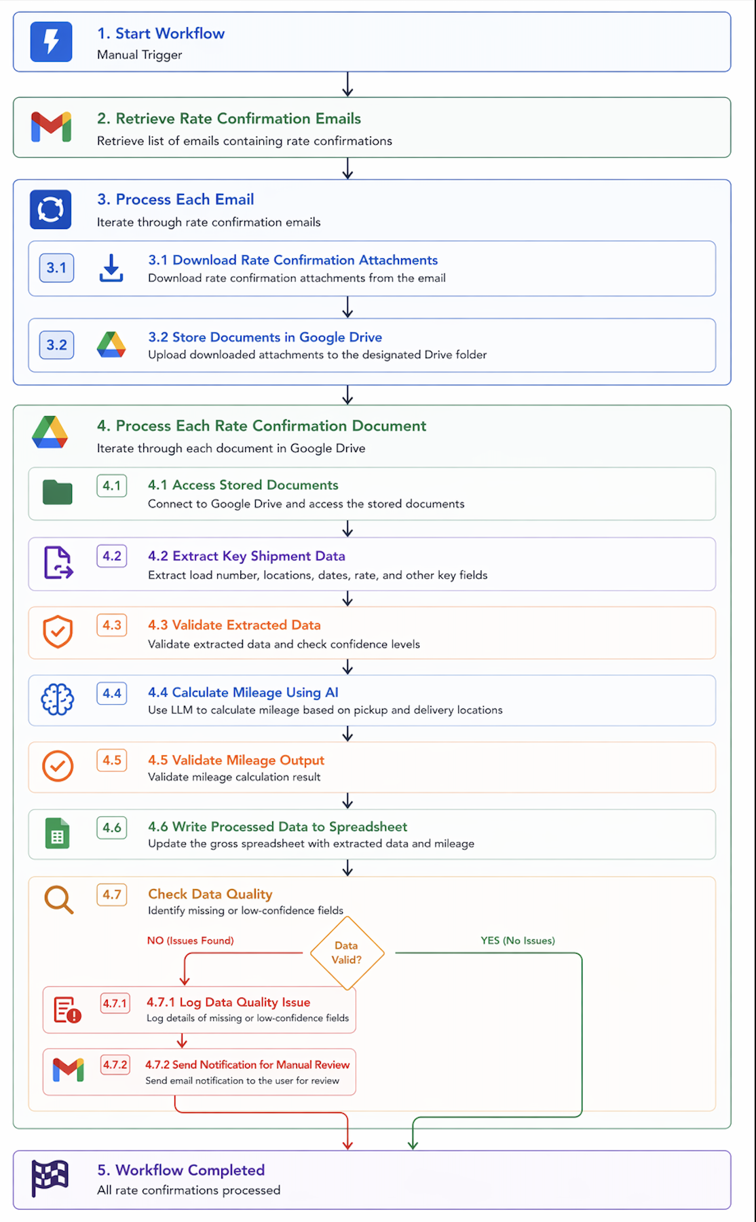
Proposed Automation Solution
This UiPath automation handles the end-to-end processing of rate confirmations, from email retrieval to data extraction, AI-based mileage calculation, and structured output, with built-in validation and error handling.

Slide 6
Automation Architecture Components
z
The automation was implemented in UiPath by combining multiple components, including email integration, file handling, document understanding, AI-based enrichment, and validation logic.
Key Components:
Email integration to retrieve rate confirmations
File storage and management using Google Drive
Document Understanding pipeline for data extraction
AI integration for mileage calculation
Validation logic for data quality control
Spreadsheet integration for structured output

Slide 7
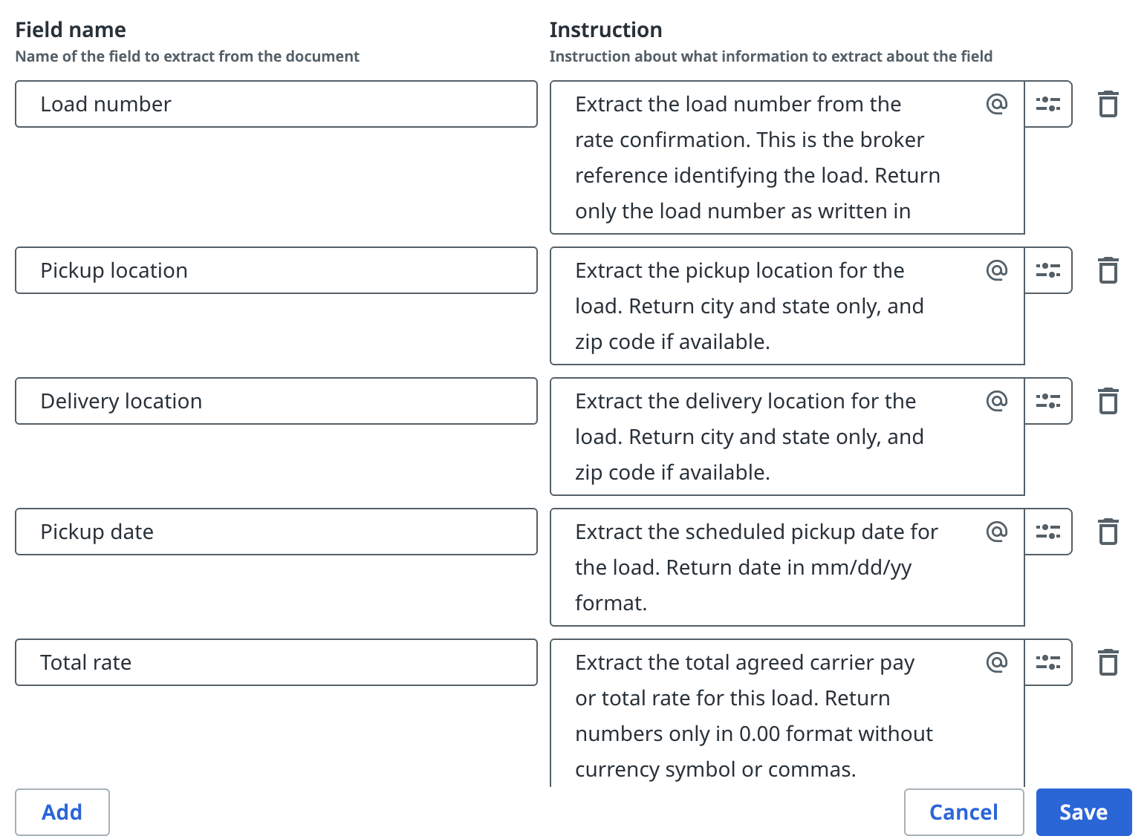
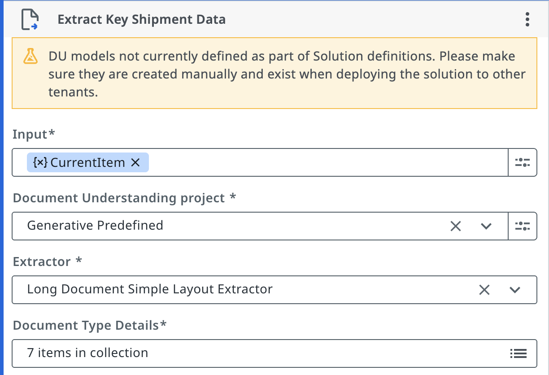
Document Understanding & Custom Extractor
z
A custom generative extractor was configured to extract key shipment data from rate confirmations, which often vary in format across different brokers.
Key Points:
Uses Document Understanding to process unstructured PDF documents
Custom fields defined for logistics-specific data:
Load number
Pickup & delivery locations
Dates
Rate
Generative extractor used for flexibility across different formats
Designed to handle varying document quality and layouts
Custom extractor enables accurate data extraction even from non-standard documents.

Slide 8
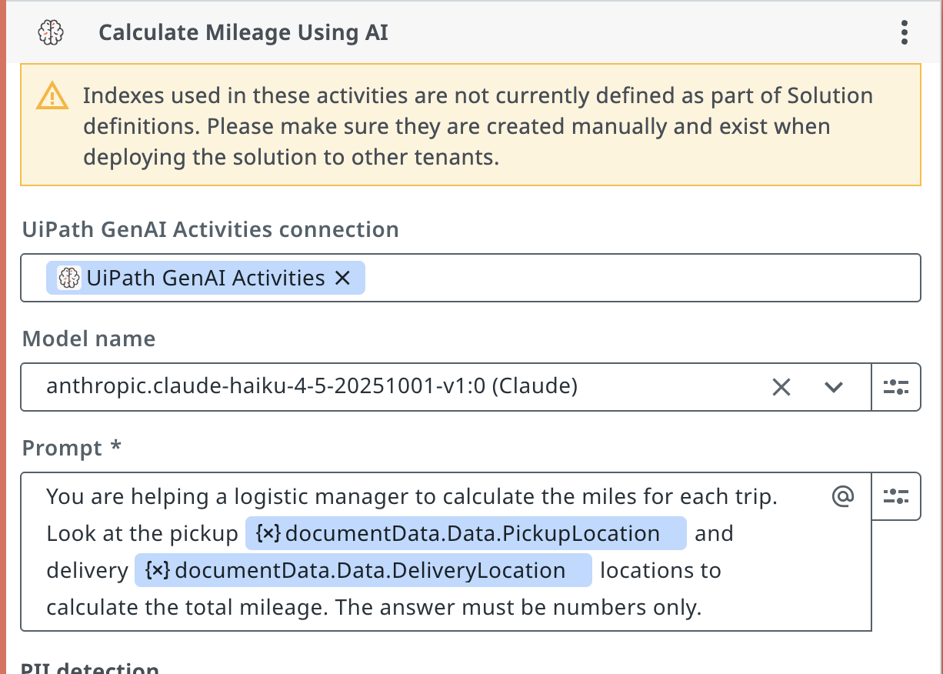
AI-Powered Mileage Calculation
z
LLM-based mileage estimation was implemented as a lightweight AI enrichment approach during initial workflow prototyping.
Key Points:
Uses pickup and delivery locations extracted from documents
Sends structured prompt to LLM
Returns estimated mileage for each trip
Eliminates manual lookup in tools like Google Maps
Ensures consistent and fast calculation
AI transforms extracted location data into actionable operational metrics.

Slide 9
Data Mapping & Debugging
Extracted and enriched data is mapped into a structured format before being written to the spreadsheet, with logging used to verify results and simplify debugging.
Key Points:
Extracted fields are mapped to structured output columns in the spreadsheet
Ensures consistent data format for reporting and analysis
Log messages used to verify extracted values before writing output
Helps quickly identify missing or incorrect data
Simplifies debugging and improves reliability of the workflow
Logging and structured mapping ensure transparency and make the automation easier to maintain and troubleshoot.
z

Slide 10
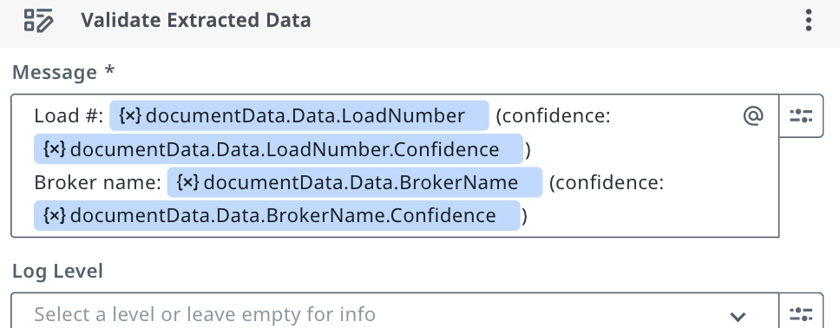
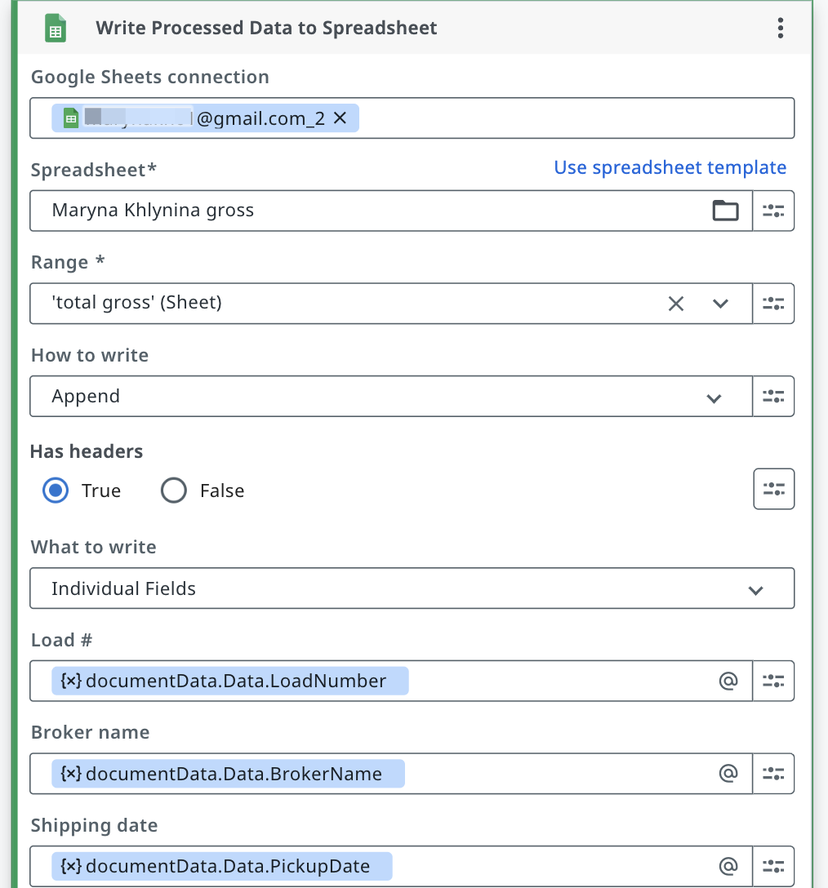
Data Mapping & Debugging
Data is mapped into a structured output format, with logging implemented to validate extracted values and ensure easier debugging.
z

Slide 11
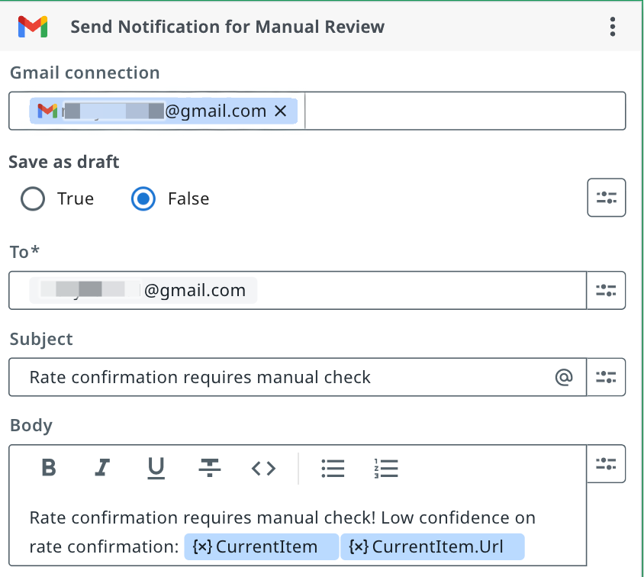
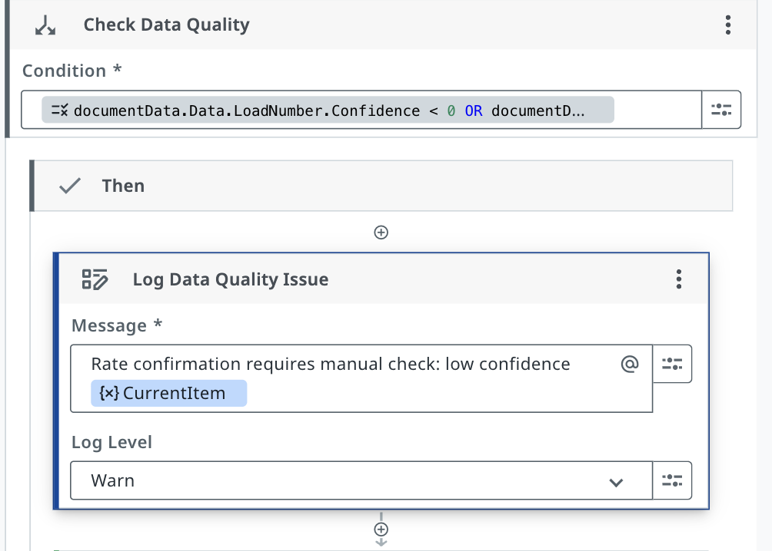
Validation Logic
z
Validation logic ensures that only reliable and complete data is processed, while identifying and flagging potential issues.
Key Points:
Identifies missing or not extracted fields (confidence = -1)
Recognizes that custom extractor fields return confidence = 0 by default
Flags incomplete or suspicious data based on validation rules
Sends email notifications for manual review
Prevents incorrect or incomplete data from entering the system
Built-in validation ensures data accuracy and reliability before final output.
In this solution, confidence scores are interpreted differently due to the use of a custom extractor. A value of -1 indicates missing data, while 0 represents extracted data without a confidence model.

Slide 12
Key Outcomes
This automation successfully processes rate confirmations end-to-end, extracting, enriching, and structuring data into a usable format.
Key Outcomes:
~70–80% reduction in manual processing
Successful mileage calculation using AI
Automated dozens of confirmations
Reduced repetitive data entry
Faster RPM reporting
Flags low-confidence data for review
The automation reliably transforms unstructured documents into structured, actionable data.
z

Slide 13
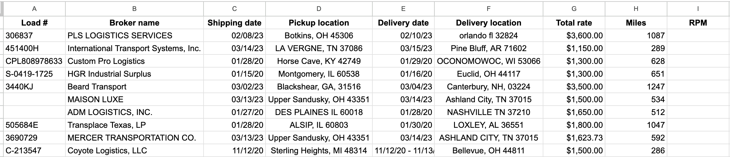
Structured Data Output
z
Processed data is organized into a structured spreadsheet, making it easy to spot missing information and ensure data completeness. With mileage already calculated, RPM can be derived instantly using a single formula applied across all entries, enabling faster and more scalable performance analysis.

Slide 14
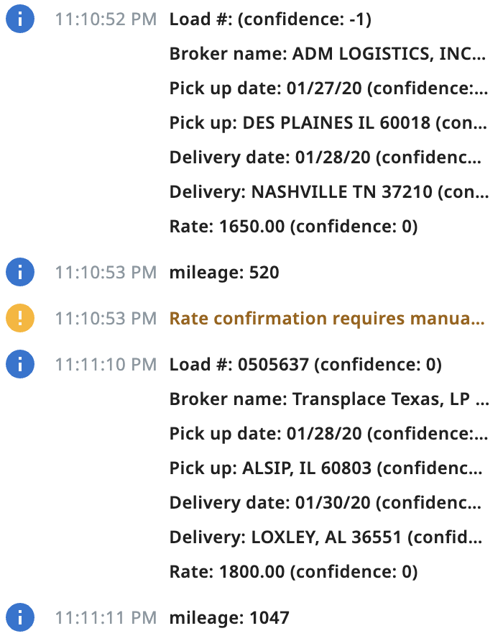
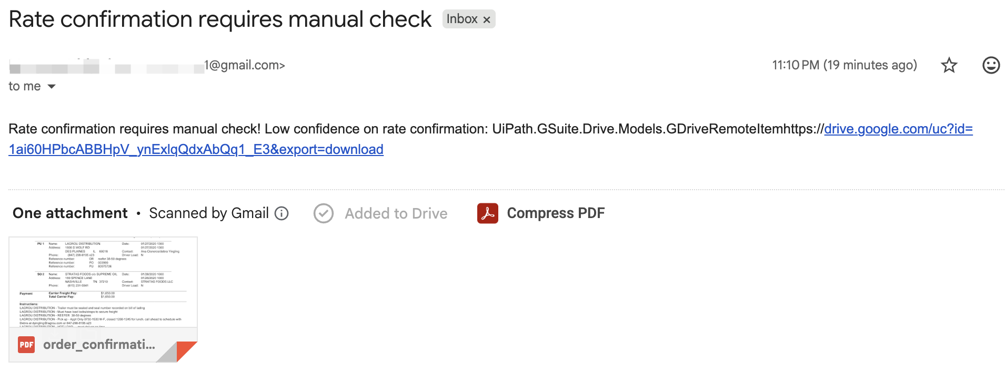
Validation & Monitoring Output
z
Confidence scores appear as 0 for custom extractor fields and -1 when no value is detected.
An automated alert triggered by validation logic when incomplete or missing data is identified in the extracted results.

Slide 15
Business Impact
Operational Improvements:
Reduced repetitive manual work
Improved reporting efficiency
Increased data consistency
Enabled scalable processing workflow
Technical Achievements:
AI-powered document extraction
Automated mileage enrichment
Validation & monitoring logic
Structured spreadsheet output
z

Slide 16
Production Readiness & Future Enhancements
How AI improved it:
Automated extraction of key shipment data from unstructured documents
AI-based mileage calculation eliminates the need for manual lookup
Enhances scalability by handling large volumes of documents efficiently
Future Enhancements:
Replace LLM mileage with Google Maps API for higher accuracy
Implement a custom-trained extraction model to improve confidence scoring and document accuracy across varying broker formats
z

Slide 17
Business Value
Time Efficiency: Automates repetitive tasks such as document review, data entry, and mileage calculation
Accuracy & Data Quality: Reduces human errors and flags missing or incomplete data for review
Scalability: Enables processing of large volumes of rate confirmations without additional manual effort
Operational Visibility: Structured data allows instant calculation of KPIs like RPM and overall performance
Faster Decision-Making: Provides clean, ready-to-use data for analyzing profitability and load efficiency
z

